Slide 1
Introduction
NEXUS SERVICE MARKETING SYSTEM
GROUP NO: 03 BATCH: T1.2208.M2
Supervisor: Lê Thanh Nhân
1.Trần Thiện Hiếu
2. Trần Văn Phát
3. Nguyễn Văn Thiện
Date: 11 Month: 1 Year: 2024

Slide 2
Content
Introduction
Actual requirements
Requirements of the project
Deployment diagram
Test result
Conclusion and development
Task list

Slide 3
Introduction - Actual requirements
1. Customer Profile Management
2. Employee and Admin Management
3. Connection and Order Management
4. Product and Equipment Management
5. Invoice and Payment Management
6. Search and Query
7. Discount and Promotion Management
8. Service Tax Calculation
9. Login Interface and Access Rights
10. Invoice and Payment Details Management
11. Information Security

Slide 4
Introduction - Requirements of the project
Functional
- Creation, maintenance and updating database, which contains
Information Regarding the various plans
Details of retail stores
Details of the employees
Details of customers, vendors are needed to be updated.
Details of the orders generated
Details of the products
Details of the materials provided with the customer
- Maintaining the records of the orders generated for the customer regarding the connection, and the products, also the feedback from the customer is to be collected
- The billing for the order is to be calculated taking into account the customer entitlements in terms of discount and schemes chosen and the payment done previously
….
Notes:
Non-functional (how the system works)
Functional (what the system should do)

Slide 5
Introduction - Requirements of the project
Non-functional
- User: Non-Functional Requirements: The website should load quickly, be responsive on different devices, have a visually appealing design, and be accessible across various browsers.
- Admin: The website should load quickly,have a visually appealing design, and be accessible across various browsers.
Notes:
Non-functional (how the system works)
Functional (what the system should do)

Slide 6
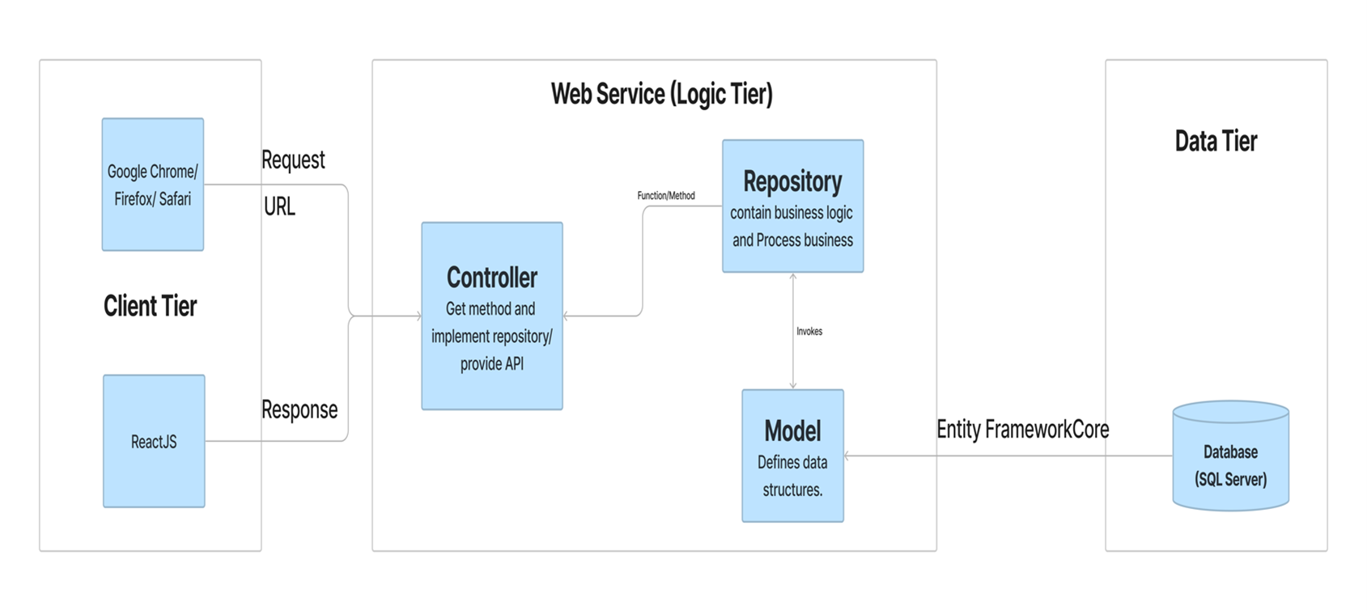
Introduction - Deployment diagram

Slide 7
Test Result [1-n]
1. Customer Profile Management OK
2. Employee and Admin Management OK
3. Connection and Order Management OK
4. Product and Equipment Management OK
5. Invoice and Payment Management OK
6. Search and Query OK
7. Discount and Promotion Management OK
8. Service Tax Calculation OK
9. Login Interface and Access Rights OK
10. Invoice and Payment Details Management OK
11. Information Security OK

Slide 8
Test Result [2-n]
- Creation, maintenance and updating database, which contains
Information Regarding the various plans OK
Details of retail stores OK
Details of the employees OK
Details of customers, vendors are needed to be updated. OK
Details of the orders generated OK
Details of the products OK
Details of the materials provided with the customer OK
- Maintaining the records of the orders generated for the customer regarding the connection, and the products, also the feedback from the customer is to be collected OK
- The billing for the order is to be calculated taking into account the customer entitlements in terms of discount and schemes chosen and the payment done previously OK

Slide 9
Conclusion
The website will help customers automate everything, making their work easier for employees. On the user side, it is also easy to consult, register for the service and pay easily

Slide 10
Development
Client: Building by Reactjs
Server: Building by API .NET

Slide 11
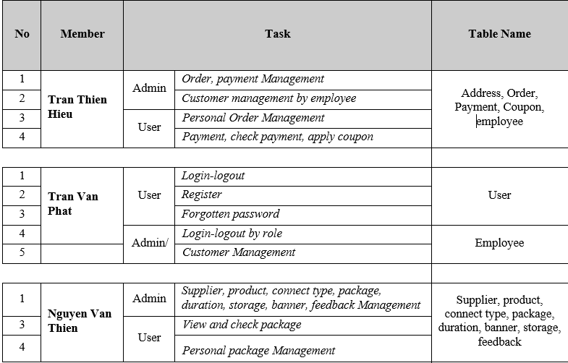
Task List

Slide 12
Reference
Refer to Viettel's website: https://viettel.vn/

Slide 13

Thank You

